Slide 1
Introduction to
Software System Analysis and Design
Part 1

Slide 2
About the Course
Course Materials
My over 20 years of IT industry experience in strategic technology planning and business application software development
Project management of business application development
Software industry best practices
Classroom Style
Lecture
Discussion
Practice
Questions and answers
Exams
Test (30% of total grade)
Design project (70% of total grade)

Slide 3
Topics Covered in This Course
Software Development Lifecycle
Development Methodology
Software Engineering Goals and Roles
Project Development Planning
Project scope
Project management
System Analysis
Requirement Gathering
Use Case Modeling
Structural Analysis
Behavior Analysis
System Design Approach
System Architecture Design
User Interface Design
Business Logic Design
Persistence Data Design
Implementation
Programming construction
Testing

Slide 4


Online Class Schedule, Q&A, Test, Group Finanl Assignment
Date of completion | 5/2 | 5/3 | 5/4 | 5/5 | 5/6 | 5/7
需完成日期
Activities & | QQ online | Part 1 | Part 3 | Part 5 | Part 7 | QQ
Online | Introduction | Part 2 | Part 4 | Part 6 | Part 8 | Online
Self-Study | 课程介绍 |  |  |  | Students | Q/A 答疑
 |  |  |  |  | Practice
网络
视频学习
Date of 5/8 completion | 5/9 | 5/10 | 5/11 | 5/12 | 5/13 | 5/14
需完成日期
Activities & Test 考试 | Part 9 | Part 11 | Part 13 | Part 15 | Part 17 | Final Group
Online 1:30 pm - | Part 10 | Part 12 | Part 14 | Part 16 | Part 18 | Assignment
Self-Study 2:00 pm | Students | 、 |  |  |  | 大作业讲解/
QQ | Practice |  |  |  |  | 问答
网络 Online |  |  |  |  |  | (提交 时间
视频学习 Q/A 答疑 |  |  |  |  |  | 5/20 8am)

Slide 5
Grading
Test
Final Project
30
70
-------------------------------------------------
Total 100

Slide 6
Course Objectives
What will you learn from this course?
Concepts about system architecture
Concepts about project management
System analysis and design concepts
System analysis and design techniques
What is the value to you?
Gain general knowledge about software engineering
Learn about system analysis and design skill
Improve key design communication skill
Increase your system thinking skill
More importantly, prepare yourself with knowledge and ability for the future

Slide 7
Main Learning Objectives
We will take a top-down approach for this course with the following subjects as the main learning objectives:
Software system analysis and design
Software analysis and design concepts
Analysis and design artifacts
Software system development lifecycle
Fundamental analysis and design process
Software system architect basic skills

Slide 8
What is “System Analysis and Design”?
Technology solutions for business
Understand the business needs
Enable business with technology solutions
Software engineering
Follow a systematic development process
Communicate artifacts of system transformation
Technology automation creation
Define system architecture
Create design models

Slide 9
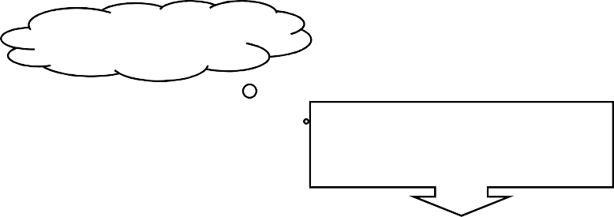

Conceptual View of System Development Process
New ideas
Re-engineering
Define Business Process
Change Business Process
Business Process Automation
Development Planning
Ourstudyfocus
System Analysis
System Design
Production System Installation
System Implementation
Production System Support

Slide 10
Software Engineering Goals and Roles
Part 2

Slide 11
Software Engineering Goals
Productivity
To easily develop and modify system designs with efficient and effective development methodology
Extendibility
To minimize the dependencies between data and functions to increase flexibility of making modifications
To design modular functions for easy of adding new business functions
Reusability
To reuse data and functions for other business opportunities

Slide 12
Software Engineering Key Design Considerations
Modularity
by data encapsulated with processing functions (i.e. methods)
Extendibility
by object independence and inheritance
Testability
▪ by high degree of object independence Component integration
Maintainability
▪ by high degree of modularity
Reusability
▪ by reuse of objects, components, and object-oriented frameworks

Slide 13








Lifecycles and Roles of System Development
Product Support Engineer
(Customer Support)
Product Manager
(Product Development)
Sales Engineer
(Marketing Support)
Product/Solution Architect
(Business Solution Architecture)
Project Manager
(Software Development)
Requirement Engineer
(Business Requirement)
Application Architect
(System Architecture)
System Engineer
(System Maintenance Support)
Design Engineer (User Experience, Data Model, Network)
Test Engineer
(System Testing)
Software Engineer
(System Development)

Slide 14




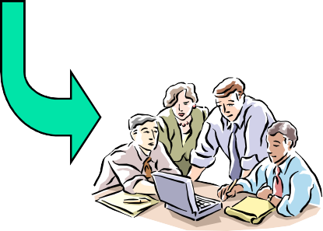

Team Work with Software Development Process
Design
Project Manager
Programming
Planning
Business Analyst / End- user Liaison
System / Network / Database Architect
Software Engineer / Developer / Programmer
System Engineer / Integrator / Usability Tester
■
■
Delivering
■
Analysis
Testing

Slide 15
System Development Methodologies
Part 3

Slide 16
What is Software System Development Methodology?
A Software System Development Methodology should:
describe an approach for software system development.
guide development teams using common steps.
define consistent artifacts (e.g. design models).
support a system development lifecycle.
support a team development environment.
be supported by a standardized set of tools.

Slide 17
Different Software Development Methodologies
Information Engineering Development Methodology
Water-fall methodology
Modular structure
Procedure processing
Object-oriented Development Methodology
Iterative methodology
Class structure
Event driven and messaging
Component-based Development Methodology
Component integration
Component reuse

Slide 18
Information Engineering Development Methodology
Pros:
Simple process
Fixed requirements
Clear phase changes
Cons:
Less flexible for changes
High degree module dependencies
High degree data dependencies
Development Planning
System Analysis
System Design
System Implementation

Slide 19
Object-Oriented Development Methodology
Pros:
Iterative analysis and design process
Flexible design changes with incremental requirement changes
Promote functional and data independence
High degree of development productivity
Development Planning
Object reuse
Cons:
Difficulty of managing project increases
Software complexity increases
System Analysis
System Design
System Implementation

Slide 20
Component-based Development Methodology
Pros:
Flexible design changes with incremental requirement changes
Promote functional and data independence
High degree of development productivity
Requirements managed independently
Clear development boundarie
Parallel development
Component reuse
Cons:
Complex component development management process
Development Planning
_{System} S_{A}y_{n}s_{a}t_{l}e_{y}m_{sis}Analysis
System ^{S}D^{y}es^{t}i^{e}g^{m}n ^{Design}
System Implementation

Slide 21
System Development Lifecycle (object oriented)
Project Management Process
Control/Monitoring
Initiating
Closeout
Planning
Execution
System
Development Process
Planning
Analysis
Design
Implementation
P (1)
A (1)
…
A (n)
D (1)
…
D (n)
I (1)
…
I (n)
iterations

Slide 22
Iterative and Incremental Process
Technology verifications / Prove the concepts
Research and development of basic system functionality
Plan Analyze Design
Add new and full system functionality
Build Test
Iteration
Iteration
... ...
20% of all use cases
Project should start with 20% of each use case out of 20% of all use cases
= 4% total development effort
20% of each use case

Slide 23
Project Development Planning
Part 4

Slide 24
Project Development Planning
Project Initiation
Identify business value
Feasibility analysis
Project Management
Develop project plan
Staff the project
Manage the project activities

Slide 25
Identify Business Value of using Technology
Project sponsors
Business owners
Customers
Business needs
New business capabilities
Business re-engineering
Functionality
Business functions
Business processes

Slide 26
Identify Business Value of using Technology (continued)
Expected value
Financial gains
Increasing market shares
Customer satisfactions
Special issues/constrains
Business limitations
Regulation limitations
Competitions in the marketplace
Market supply/demand limitations

Slide 27
Feasibility Analysis
Technical Feasibility
i.e., can we build the system?
Familiarity with business application
Familiarity with technology to be used
Manageable project size

Slide 28
Feasibility Analysis (continued)
Economical feasibility
i.e., is it worth to build the system?
Cash flow
Pay for the development resources (people, hardware, software, etc.)
Total Cost (TC) of years
Development costs
Operating costs
Total Benefits (TB) of years
Reduced cost of labor reduction and efficiency
Additional revenues generated
Total Net Benefit (TNB) = TB – TC
Return on Investment = TNB/TC, (ROI is % value)
Net Present Value = TNB / (1+interests)^{years}
Intangible costs and benefits
Market presences
Reputation
Brand recognition

Slide 29
Example
 | Year 1 | Year 2 | Year 3 | Total
New Development Cost | $2500 (software and labor) |  |  | $2500
New System Support Cost (new development) |  | $4000 (people and system) | $3500 (people and system) | $7500
New Business （benefits) |  | $200 | $300 | $500
Current System Support Cost (no change) |  | $5000 | $5000 | $10000
TNB = TB –TC
= Cost Saving + new business – initial cost of development
= [($10000 - $7500)+ $500] - $2500 = $500
ROI = 500/2500 = 20%
Net Present Value = $500 / (1+4%)³ = $444.5 (value of today)

Slide 30
Feasibility Analysis (continued)
Organizational Feasibility
i.e., who will support the system?
Project champion (e.g. key business or technology management)
Senior management (e.g. company’s leadership management)
Users (e.g. customers)
Other stakeholders (e.g. internal and external business partners)
Page 30

Slide 31
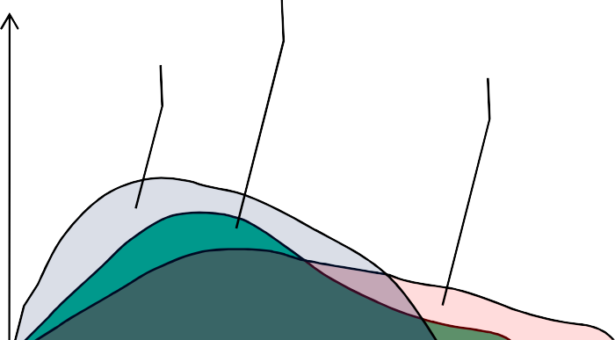
Develop Project Plan
Identifying tasks
Activities
Deliverables
Task hours
Assignments
Time estimate
Resource
Optimal-staffing
Over-staffing
Under-staffing
Project Effort
Project milestones
Time
Resource planning (i.e., when/how many people on project)
Create an overall project plan
Project effort staffed with appropriate resources:
Resource (number of staffs) matched Time (milestones)
Overhead increased situations (project costs increased)
Under staffing (project time will be longer, overhead increased)
Overstaffing (project productivity reduced, overhead increased)

Slide 32
Staff the Project
Staffing plan
Team members (what are the roles and the needs)
Skill requirements (what expertise the project team needs)
Project team structure (who plays what role)
Number resources according to the project plan schedule

Slide 33
Project Management Activities
Manage the scope
What is (or is not) to be delivered
Refine the estimates
When will tasks be done
Track the tasks
Who is doing what
Coordinate the project
Who is responsible for what to happen and when
Mitigate the risks
How can contingency plans reduce the failure risk of the project

Slide 34
System Development - Planning Summary
Phase | Step | Technique | Artifacts
Planning (Why build the system?) | Identifying Business Value | System request and dependencies | Business request and requirements
 | Analyze feasibility | Technical feasibility | Feasibility study
 |  | Economic feasibility
 |  | Organizational feasibility
 | Develop work plan | Task Identification | Work plan
 |  | Time estimation
 | Staff the project | Creating a staffing plan | Staffing plan
 |  | Creating a project charter | Project plan
 |  | (goals and plan)
 | Control and direct project | Refine estimates | GANTT chart
 | (throughout the project) | Track tasks | CASE tool
 |  | Coordinate project | Standards list
 |  | Manage scope | Project binder(s)
 |  | Mitigate risk | Risk assessment

Slide 35
System Analysis
Part 5

Slide 36
About System Analysis
Purpose
Analysis Process
Business System and Technology System
Business process automation
Business reengineering

Slide 37
What is the Purpose of Analysis?
Capture the business requirements with models
Transform the business needs into technology implications
Understand what functions to be built for the business
Model the business information for future design solutions

Slide 38
Analysis Process
Understand as-is system (current environment)
Understand the current system
Capture the current business and technology environment
Identify improvement opportunities (changes needed)
What are problems that should be solved
What are the priorities
What are the cost-effective opportunities
Develop to-be system (future environment)
Revise the as-is system
Modify existing and add new processes
Modify existing and add new data
Model and recommend the to-be system

Slide 39
Business System and Technology System
What is a business system?
A depiction of a real world business including: Business process, Business data, Business organization, Business operation rules, Business policies, etc. ……
What is a technology system?
A depiction of a technology system (solution) for a business system including:
System process, System data, System structure, etc. ……
Technology systems support the business systems and automate the business processes.

Slide 40
Business Process Automation
Automate the business with technology (why to change)
Change from manual to automation – faster (e.g. on-line banking vs. paper)
Use technology to improve business tasks – more accurate
Analysis methods to determine an automation area (where to
change)
Duration analysis
Activity-based costing
Informal benchmarking
Formal benchmarking
Business Process Development Automation Planning
System Analysis
Follow the analysis process (about how)
Understand as-is system (current environment)
Identify improvement opportunities (changes needed)
Develop to-be system (future environment)
System Design
System Implementation

Slide 41
Business Reengineering
Change current business process
Increasing business value
Create business opportunities
Apply the analysis process to
Outcome analysis – change value produced for customers
Breaking assumptions – change reasoning/rules
Technical analysis – leverage technology
Activity elimination – reduce steps in the process
Proxy benchmarking – borrow ideas from different industry

Slide 42
Developing an Analysis Report
Justify the cost for the benefit of business value
Changeimpactincreases
Analysis Objective | Business Process Automation | Business Process Improvement | Business Process Reengineering
Potential Business Value of Return | Low-Moderate | Moderate | High
Project Cost | Low | Low-Moderate | High
Breadth of Analysis Needed | Narrow | Narrow- Moderate | Very broad
Risk of Change | Low-Moderate | Low-Moderate | Very high

Slide 43
Requirement Gathering
Part 6

Slide 44
Business Requirement Gathering
Selecting appropriate techniques to gather business requirements:
Document Analysis
Based on the exiting documentations
Questionnaires
Information in writing from individual(s)
Interviews
Information from meeting of individual(s)
Joint Application Design (JAD)
Information from meeting of group(s)

Slide 45
Document Analysis
Research existing documentation
Business process and data
Business management
Syntheses the information
Findings
Identify gaps
Make recommendations as requirement
Changes needs
Suggestions

Slide 46
Questionnaires
Selecting Participants
Business representatives
Subject matter experts
Design the Questionnaires
Categorize the questionnaires
List important items
Straight forward and unbiased
Set them at a right level without ambiguity
Administrating the Questionnaire
Get participants to complete questions
Explain why the questionnaire is conducted
Clarify any questions
Follow-up
Get back to the participants to make sure work completions

Slide 47
Interviews
Selecting Interviewees
Name
Position
Purpose of interview
Meeting
Designing Questions
Close-ended questions – Specific needs
Open-ended questions – Uncover needs
Probing questions – Confirm the needs’ certainty or clarity
Level of questions:
High-level: very general
Medium-level: moderately specific
Low-level: very specific

Slide 48
Interviews (continued)
Preparing for the interview
Plan - topic
Questions – purpose
Open-ended questions are easier to prepare than the close-ended
Possible answers – confirmation
Conducting the interview
Build trust
Professional
Unbiased
Document accurately
Follow-up
Written interview report
Confirm interview points
Clarify additional questions

Slide 49
Joint Application Design (JAD)
Selecting Participants
Who should join the JAD session
Designing the Session
What topics to go over and get results
Preparing for the Session
What materials to prepare before the session
Conducting the Session
Facilitate the discussion and engage with the participants
Follow-Up
Any additional information to get from the participants identified at the session to complete the tasks

Slide 50
Selecting Appropriate Techniques
Techniques | Document Analysis | Questionnaires | Interviews | JAD
Gathered information | As-is | As-is, Improvement | As-is, Improvement, To-be | As-is, Improvement, To-be
Depth of information | Low | Medium | High | High
Breadth of information | Medium (depends on availability) | High | Low | Medium
Integration of information | Low | Low | Low | High
User involvement | Low | Low | Medium | High
Cost | Low | Low | Medium | Medium-High

Slide 51
Use Case Modeling
Part 7

Slide 52
Modeling
What does modeling mean?
General purposes
What is to model?
Subject contents
Use case modeling
Concepts
Structures
Development

Slide 53
What does Modeling Mean?
Modeling is to depict the real world information with artifact (representations) so that …
We capture meaningful information in the scope of interests
i.e.Useful model with relevant information
e.g. Business processes, technology systems
We know how to utilize the information for developing solutions
i.e. Meaningful model with purpose
e.g. Designs for building system
We can communicate and share it with development team
i.e. Understandable model with communicable notation
e.g. Graphical and textual descriptions for users to understand

Slide 54
What is to Model?
Model what is in the context
e.g. business rules, technology constrains
Model information at a right level
e.g. analysis level, design level
Model complex information with different level of abstractions
e.g. subsystems, packages

Slide 55
Use Case Modeling
What is Use Case?
“A use case is a sequence of transactions in a system whose task is to yield a result of measurable value to an individual actor of the system.”
Ivar Jacobson
In other words
A use case describes a sequence of “system” activities from its user’s perspective.
Therefore
Use cases describe how a system will be used
Use cases specify what business requirements are
Use cases define system’s functionality and scope
Use cases provide specifications of a system capability
Use cases create basis for system testing

Slide 56
Use Case Modeling Concepts
What is use case for?
Define what is to be performed by the “system”.
Who develops use case?
Jointly developed by the end-users and the “system” development team.
Check book (Borrower's ID)
<<include>>
Borrower
Handle Check book
Update book record
Lib rary Syste m

Slide 57
Use Case Model Structure
Use Case Model Contains:
Use case diagram (graphical representation)
A graphical depictions of how a system is used in a particular context with the involved actors.
Actor
▪ Role in the context of use case
▪ Initiator or receiver of service
▪ External Systems
Use case (textual description)
Use case event
Use case relationship
▪ Communications: between actors and use cases
▪ Includes: between a use case and a shared use case by another use case
▪ Extends: between a core use case and an extended use case (extension or alternate course of the core use case)

Slide 58
Use Case Model Structure (continued)
Use Case Modeling Level
Main use cases
Detail use cases
Borrow book ( Student ID)
<<include>>
Check-out book
<<i nclude>>
Return book ( Borrower's ID)
Update book record
Borrower
Check-in book
<<extend>>
Recall book ( Book ID)
Charge late-ret urn fee
Notify book return
Library System

Slide 59
More about Use Case
Use case is an analysis technique, which can be used in different contexts of modeling “system” and at different levels (conceptual or logical). This system can be application, component, etc.
Use case gives the abstraction of the system from the perspective of its “actor” (i.e., business users, applications, or components interfacing the system).
Use case describes the process (activities) performed by the system. It is generally trigged by actor(s) along with some pre-conditions or post-conditions. Alternate steps maybe described if certain conditions are met. This may include any exception handlings.
Use case diagram is a collection of actors, use cases visually depicting their relationships (e.g., actors trig use cases or use cases associate with other use cases).

Slide 60
Develop Use Case Model
Identify the Main Use Case
Find the system’ boundaries
List the primary actors
List the goals of the primary actors
Identify and write the main use cases
Review the main use cases
Expand the Main Use Case to Detail Use Cases
Choose main use cases to expand (for further analysis)
Fill in details of the chosen use cases (becomes detail use cases)
Write the normal flow of the events of the use case
Complex or long flow can be sub-flows
Identify alternate or exceptional flows
Write the use case in terms of “who does what to whom” to provide clarity
Write specific condition, rules and any technical requirements as part of the activities

Slide 61
Develop Use Case Model (continued)
Confirm the main use case
Review the main use cases to make any adjustments
Use packages to manage complex business functional requirements
Create use case diagram along the way
Determine the system boundary
Place the use cases on the diagram
Place the actors on the diagram
Draw the associations
Use case events
Use case relationships

Slide 62
How to write a use case?
Identify (discover) an appropriate level of use cases to write
Main use cases: Abstract or generalized sequence
Detailed/Expanded use cases: Specific sequence
Start with an actor
A person who initiates the event
A system which triggers the event
End with a completion of an activity thread performed by the system

Slide 63















Use Case Model Example – Use Case Diagram
Telemedicine System Use Case Diagram
Manage Patient Profile
Telemedicine
Update PHR
Manage Physician Profile
Manage Services
<<home>>
Patient
Look up Patient Treatment History
Manage User Registration / Identification
Manage Video
Make Payment
Sign on Service Session
Manage Audio
Physician
Notify Session Status
Manage Service Schedule
Manage Chat

Slide 64
Use Case Model Example – Use Case Description
Telemedicine System Use Case Descriptions
Manage Services <<Home>>
This is the home page for users to browse the general information about Telemedicine, which has links to the activities that patients and physicians can perform after having registered and sign on successfully. The intent is to have as much flexibility as possible in principle. The activities may be performed by the patients and physicians are independent until they are in a session. The following links will be shown on the home page to access medical service or medical data. They are described by each use case respectively:
Register
Sign on Service Session
Manage Patient Profile
Manage Physician Profile
Update Patient Treatment History
Update Patient Health Record
Manage User Registration / Identification
This use case manage users’ registration and sign-on authentication:
Register user and/or
Authenticate users at the beginning of accessing the services and data.

Slide 65
Use Case Model Example – Use Case Description
Telemedicine System Use Case Descriptions
Sign on Service Session
After successful sign-on verification, a patient will start a session for service. There are two types of sessions:
On-demand: (request on the fly and waiting for a physician online to response)
Scheduled (pre-schedule time slot with a physician signed up for, see use case Manage Service Schedule)
Start a session with a service request that will lead to Make Payment before a service can be granted.
Once a successful payment is made, a session then can be started, including a set of physical conditions will be entered by the patient.
In a case of On-demand:
Patient will be put on a waiting list until a doctor is sign on/response to the request. The waiting list may be sorted by time, treatment need or by name. (go to step 3) In a case of scheduled:
See use case Manage Service Schedule
Scheduled time can be modified any time hereafter for change.
A session gets started when a doctor who has signed in and respond to a service request. When both the patient and the doctor are ready for the session with options available (they are described in each use cases respectively):
1.Chat 2.Audio 3.Video
A generic note of SOAP is created for the physician to capture the information pertain this service:
Subject - the patient name
Objective – Service request purpose
Assessment - the record of diagnoses including text, image
Plan – treatment plan and medication prescribed.
The note will be saved in the system for future reference. Patient will be notified for information.
<<Option>>
A physician may schedule a follow up of treatment services by opening the scheduler for future appointments, which put both physician and patient to a specific date/time through Manage Service Schedule.
Use case ends with session closed.

Slide 66
System Modeling with UML
Part 8

Slide 67


How do We Specify Software Systems?
Need a software development process
Need design models to describe the systems
Planning
Analysis
Design
Development Process
Design Models
Software Systems

Slide 68

What do We Use to Model Software Systems?
Unified Modeling Language (UML)
Requirements Analysis
Realized
Design
Implemented
Implementation
Verified
Test Plan
Testing

Slide 69
UML Offers Features for System Modeling
Model Elements
Representations for system structures and interactions
Relationships
Representations for system static and dynamic relationships
Diagrams
Graphical models of static and dynamic information about the system
Common Mechanisms
Annotations and user defined information
Architecture Views
Models for different system perspectives

Slide 70
Model Elements in UML
Use Case - A way in which an external actor uses a system
Class - The definition of objects that share a common structure and common behavior
State - A stage of lifecycle in which an object instance is in
Package - A logical grouping of model elements
Component - Physical implementation of a software unit
Node - A hardware processor on which the software units execute

Slide 71
Relationships in UML
Association - A semantic connection between two classes/instances of objects
Generalization - A relationship between an element and the elements that specialize it
Interface - Mechanism offered by an element for others to access its functions
Dependency - An element is need by another Aggregation - An elements is part of another element Navigability - An unidirectional association
0..*
Multiplicity - Specification of an (+) integer range of allowable cardinalities

Slide 72
Diagrams in UML
Use Case Diagram (UML 1.x and 2.x)
shows the external view of how a system is used
Composite Diagram (UML 2.x)
shows the system structural parts, ports and interfaces
Class Diagram (UML 1.x and 2.x)
shows the class hierarchy and static relationships
Communication Diagram (UML 2.x)
shows interaction among objects organized in spatial network
Sequence Diagram (UML 1.x and 2.x)
shows interaction among objects organized in temporal order
Statechart Diagram (UML 1.x and 2.x)
shows states and conditions that cause state changes of an object
Activity Diagram (UML 1.x and 2.x)
shows activity flows or algorithms and controls of use cases or objects
Component Diagram (UML 1.x and 2.x)
shows the implementation components in a system and their dependencies
Deployment Diagram (UML 1.x and 2.x)
shows a system placement of nodes, networking and process distribution
Get more information about UML: www.omg.org/uml

Slide 73
Common Mechanisms in UML
Specifications
A textual description of additional details about an element
Adornments
Details rendered as graphical attachment to basic symbols
Notes
Arbitrary text comments attached to elements
Constraints
Textual specifications of or conditions imposed on relationships
Stereotypes
Creation of a new kind of model elements adapted from an existing model element
Properties
Tag-value pairs to attach arbitrary information to model elements

Slide 74

Use UML to Model Applications Analysis and Designs
Conceptual Representations
UML Representations
Variants of Applications
Conceptual View
Use Case View
Distinct Applications
System Structure View
System Process View
Logical View
System Structure
View
System Process
View
Specific Business Domain Components (business portfolio-level)
Cross Business Domain Components (enterprise-level)
Implementation Component View
Component Deployment View
Physical View
Implementation
Component View
Component
Deployment View
System Software

Slide 75







UML Can Model Business and Technology Systems
Business Event
Application Capability
Application Flow
System Component
Component Structure
Business Process
Data Model
Technology Deployment

Slide 76
Structural Modeling
Part 9

Slide 77
Create System Components using Objects
Business Component
Logically grouped business functions with objects
For business applications
Objects (integrated together) interacting to complete a set of business processing
System Component
Non-business specific
Technical utilities to support lower-level system functions
Built or supplied by technology vendors for supporting business component developments

Slide 78
Object Oriented View
View the world by objects
Analyze information by objects
Relate objects by associations
Communicate to objects by messages
Object Oriented View
An Object
Build systems with objects
User interface
Business logic
Information brokers
Data storage
Data
Behavior
Process

Slide 79
Objects are ……
Defined by classes with object-oriented approach
▪ Contains information about itself attributes and/or states.
▪ Has behaviors internally (private methods) and interface (public methods) available for other objects.
Supported by object-oriented programming languages, JAVA, C++, C#, etc.
Implemented as software program units of component or applications

Slide 80
Object Oriented Concepts
Object
Packaged with data and behavior
Class
Object classifications
Encapsulation
Information hiding
Inheritance
Information generalization and specialization
Polymorphism (multiple forms)
Objects (and all subclassed objects) can be referenced and methods can be involved through dynamic bindings.
e.g. in OO Programming: SHAPE has <<subclass>> SQUIRE, TRIANGLE, CIRCLE for i := 1 to 10
{aShape := SHAPE[i];
shapeArea[i] := aShape.computeArea}
// SHAPE[i] can be SQURE or TRIANGLE
// SQURE.computeArea or TRIANGLE. computeArea

Slide 81
Class Diagram for Structure Modeling
Class
Attributes - Data
Operations - Function
Associations
Static – Cardinality, Containment, Inheritance
Dynamic – Messaging (more discussed in Behavior Modeling)
Class Diagrams (not just for objects)
System-level
Component-level
Object-level

Slide 82

Class Diagram – Library Example
Library Personnel
Book Management
Book
Library ID Name
Book Name Book ID (ISBN)
Book Type Lending Status
Check-in Book() Check-out Book() Record New Book() Check Book Status()
Get Library ID()
1..*
1
1
1..*
Set Lending Status() Get Lending Status()
Librarian
Borrowe r
Authorization Level
Book Borrowed Borrower Name Borrower ID
Get Authorization Level()
Get Books Borrowed() Set Books Borrowed() Borrow Book()
Return Book() Recall Book()
Re feren ce B oo k
Text Book
No ve l
Subject Type
Co urse
Cat eg ory
Stu de nt
Teacher
Class Level
Teaching Class
Get Class Level()
Get Teaching Class()
Library System Structural Model

Slide 83
Behavioral Modeling
Part 10

Slide 84


Develop System Analysis Models
Use Case Package
Business Functions
Use Case Model
(External view)
Use Case Package
Business Processes / Activities
Use Case Diagram
Use Case
Realization
(Business domain objects)
Collaboration Diagram
Actor
Sequence Diagram
Analysis Model
(Internal view)
Business Requirements (Rules and constraints)
Class Diagram
Class
State Diagram

Slide 85
Model the System Behaviors
Use Case View (system external view)
What business needs
What business conditions
What business functions
Interaction Diagram (system internal view)
How the need should be satisfied
How the conditions are applied
How the functions are carried out

Slide 86
System Interactions
Collaboration Diagram
(Communication Diagram in UML 2.0)
For functional analysis
Complexity
Distribution
Sequence Diagram
For sequencing analysis
Operation order
System availability
Data availability

Slide 87
Using Collaboration Diagram
(Communication Diagram in UML 2.0)
4: Check-out Book(ISBN )
7: Set Books Borrowed( )
2: Check Book Status(ISBN )
Student : Borrower
1: Check-out Book(ISBN)
School : Book Management
6: Borrow Book(ISBN )
3: Get Lending Status(ISBN)
5: Set Lending Status(Out)
Software Engineering : Book
Collaboration Diagram - Check-out Book

Slide 88
Using Sequence Diagram
School : Book Management
Student : B orrower
Drama : Novel
Check Book Status( )
Recall Book (IS BN)
Get Books Borrowed(ISBN)
Set Lending Status(Recalled)
Return B ook(ISB N)
Set Books Borrowed(ISBN)
Check-in Book( )
Set Lending Status(In)
Sequence Diagram - Recall Book

Slide 89
Model System, Component, Object States
What to model?
Initial state
Trigger event
Every new state
All possible end-states
When to model?
States represent different business conditions
States represent different business processing steps
States represent different business values

Slide 90

Statechart Diagram
New Book Registed
Check-out Book
Record New Book
Checked-in
Check-in Book
Checked-out
Remove Book
Check-in Book
Recall Book
Recalled
Statechart Diagram - Book Lending Status

Slide 91
Model System, Component, Object Activities
What to model?
Trigger event
All activities
Conditional/un-conditional steps
Messaging to other systems, components, objects
When to model?
Clarify business activities
Clarify business processing steps
Clarify system, component, object control flow

Slide 92


Activity Diagram
Sys tem Trigger
Daily Book Lending Maturity
Matured Book?
Student : Borrower
- Books Borrowed
Reference : Book
- Lending Status
Student : Borrower
- Books Borrowed
Recall Book
If Pass Due?
Process Lat e Fee
End P rocess
Activ ity Diagram - Manage Book Circulation

Slide 93
System Development – Analysis Summary
Phase | Step | Technique | Artifacts
Analysis | System analysis | Problem analysis | Analysis report
(Who, what, when, where will the system be?) |  | Benchmarking Reengineering
 | Information gathering | Interviews | Requirement information
 |  | Questionnaires
 | Use case modeling | Use cases | Functional models
 |  | Use case models | (business automation)
 |  | Activity diagram
 | Structural modeling | Class diagrams | System structural models
 | (static)
 | Behavioral modeling | Sequence diagram | System interaction models
 | (dynamic) | Collaboration diagram
 |  | Statechart diagram

Slide 94
System Design Approach
Part 11

Slide 95
From Analysis to Design
Software System Development Strategies
Packaged Software (buy existing systems)
Off-shelf commercial software products
General purpose software products for customization
Business components for development
Non-business components for development
Application frameworks for development
Outsourcing (give others to design and build the system)
Software vendors
In-house consulting and development
Custom Development (design and implement by yourself)
In house software development teams
Develop software products
Develop special purpose applications

Slide 96
Selecting Development Strategy (Objective)
The objective is to meet the business needs and the time table
Determining Factors | Choose Custom (in-house) Development if … | Select Package Solution if … | Look for Out-sourcing Development, if …
Business Need | unique need | Common need | Not core technology for the business
In-house Experience | Existing business and technical experience | Existing business experience | Both business and technical experience do not exist
Project Skill And Management | Ability to build | Not strategic skill | Strategic outsource direction
Time Table | Flexible solution | Quick solution | Flexible skill available for development, but may not as quick

Slide 97
Custom Software System Development Approach
Transform Analysis Models into Design Models
Factoring – generalization
Abstract functional behaviors
Abstract common data relationships
Group coherent functions and data
Partitions – reduce complexity
Components
Subsystems

Slide 98


Use UML to Create System Design Models
Use Case
Business Requirements (Rules and constraints)
Collaboration Diagram
Analysis Model
Sequence Diagram
Logical Systems / Components
Class Diagram
Logical Package
Transformation
(Change/Add to Implementation Level Classes)
Class
Logical Package
State Diagram
Dynamic
Implementation-level Collaboration Diagram
Design Model
Implementation-level Sequence Diagram
Technology Requirements /Implications
Static
Implementation-level Class Diagram
Copyright 2003-2022 Steve Wu
Implementation-level Class
Page 98

Slide 99
Structure Your Application
Architecture Layers (top to bottom)
Business application specific
Non-business application specific
Business domain components
Non-business domain components
System components
Application Tiers (front to back)
User interface – presentation
Business functional logic
Back-end business data management
Package Application Components
Cohesive business functions in scope
Implementation of coherent processes and data
Runtime component distribution on platforms
Page 99

Slide 100

Design Applications
Applications
Each Line of business
Business domain
Variants of Applications
Component
Distinct Applications
Components
Object
High granular units of software
High cost-effective, harder to build
Specific Business Domain Components (business portfolio-level)
Objects
Low granular units of software
Good reusability, easy to build
Cross Business Domain Components (enterprise-level)
System Software
Page 100

Slide 101

Example of Library System Design
Analysis Model
Student
Library Management
Book
Design components/objects from Analysis Model
Student
Library
Book
Management
Student
Book Administration
Book Manager
Design Model
Book Manager
Book Activity Manager
Circulation
Book
Fee Process Manager
Book

Slide 102
System Architecture
Part 12

Slide 103
System Architecture and Infrastructure
System Architecture Designs
Making an Architecture Choice
Design System with Quality and Reusability
Infrastructure Design
Application Deployment Model

Slide 104
System Architecture Designs
Server-based
Client-based
Client-server
Distributed multi-tiered

Slide 105
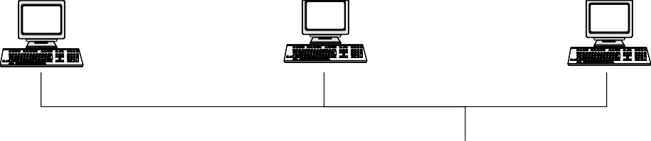
Server-based
Easy to manage
Less flexible and versatile
Mainframe
Presentation Logic Application Logic Data Access Logic Data Storage

Slide 106

Client-based
Versatile user experiences
Difficult to change and upgrade
Higher cost
Presentation Logic Application Logic Data Access Logic
Client
Client
Client
Data Storage
Data Server

Slide 107

Client-server
Versatile user experiences
Scalable for data accessing
Harder upgrade
Higher cost
Presentation Logic Application Logic
Client
Client
Client
Data Server
Data Access Logic Data Storage

Slide 108

Distributed multi-tiered
Versatile user experiences
Easy to manage and upgrade
Scalable for application and data processing
Low cost
Presentation Logic
Client
Client
Client
Application Logic Data Access Logic Data Storage
Web Server
Application Server
Application Server

Slide 109
Making Architecture Choice
Web-enablement are all possible in these architecture configurations
Measurement | Server-based (Mainframe) | Client-based (Desktop) | Client(rich)- server (2-tiers) | Thin/Rich- Client (N-tiers)
Cost of Infrastructure | Very High | Medium | Low | Medium/High
Cost of Development | Medium | Low | High | Medium/High
Ease of Development | Low | High | Low-Medium | Medium
Interface Capabilities | Low | High | High | High
Control and Security | High | Low | Medium | Low
Scalability | Low | Medium | Medium | High

Slide 110
Design System with Quality and Reusability
Granularity - Modula and functional decoupling
Interface - Consistent and interoperable
Security - Protect the business
Scalability – able to handle large business data volume and users
Performance - Efficient and high throughput
Extensibility - Easy to modify and add new functionality
Reliability - High degree of fault-tolerance
Testability - Less programmable errors
Portability - Develop once use everywhere
Page 110

Slide 111
Infrastructure Design
Technology Deployment Model
System topology (locations)
System connectivity (LAN,WAN, Wireless)
System process distributions (business functions)
Hardware and Software Specification (requirements)
Choices of hardware
Platforms/OS (operating system)
System operational environment
User/client environment

Slide 112
Application Deployment Model (UML)
<<External Business System>>
Credit Report
System
<<Local Database>>
DB2
<<Client>> Customer
<<Internet>>
<<Internet>>
Web Server
<<Local Network>>
Campus
Application Server
Corp Net
<<Client>> Business
User
Build Web pages Handle Client Request
Access Customer Record Credit Evaluation Serialize Object
Handle Service Request
<<Intranet>>

Slide 113
Application Design
Part 13

Slide 114
Guiding Your Designs
Architectural Planes
Purposes of Design Models
Design Principles
Design Best Practice
Design Heuristic
Design Techniques and Considerations

Slide 115
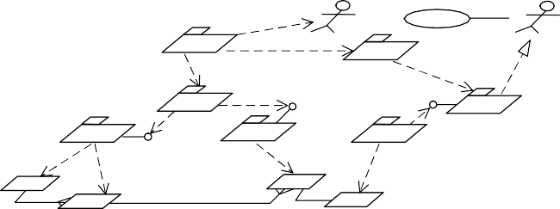




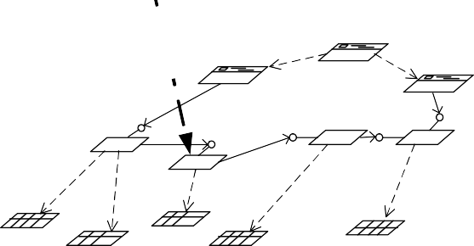









Architectural Planes
Business
Use Case
Business Functional
Component
Business
Business Architecture
Business processes
Business requirements
Conceptual
Data Model
Conceptual Plane
Application
Use Case
Application
Application Architecture
Application analyses
Component
Data Model
Logical
Application designs
Design Plane
User Interface
Data Architecture
Business data
Physical designs
Component/
System Model
Data Model
Physical
Implementation Plane
Technology Architecture
Infrastructure
System software and hardware
End-User
Client
Internet
Middleware
Network
DBMS
Platform Plane

Slide 116



















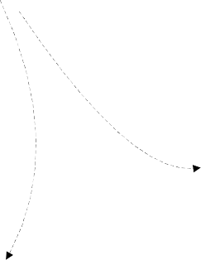








System Model Transformation

Slide 117
Purposes of Design Models
To show how a system is designed to work
Transformed the business activities captured from the analysis object model.
To show what a system needs to have
Implementation-level classes and relationships
Decomposed and added transient classes to support the implementation.
To meet needs of all business use cases
All the design models satisfies the use case requirements
Transform all analysis object models into design object models

Slide 118
Design Principles
A class should have a key abstraction
Group coherent functions, not just a collections of data and functions
Hide (encapsulate) all data within its class
Use object interfaces to get data
Keep classes independent as much as possible
For potential reuse and easier to extend
Distribute system functions among the component evenly
Balanced functional distribution among the component structure

Slide 119
Design Best Practice
Keep related data and behavior in one place
Factor the commonality of data, behavior, and/or interface as much as possible in an inheritance hierarchy
Use public interfaces of a class (or a component) for accessing data
Implement a minimal public interface that all classes understand.
Make roles as attributes of a class instead of each role as different classes, if they have common responsibilities/behaviors (e.g. father and mother is attribute value of parent)
An class should minimize the number of class it collaborates with for loose-coupling
A container class should know what it contains, and the contained classes should not have to know who contains it (so that the class is reusable elsewhere)
The derived-class should not know anything about its supper class (so that it is independent for reuse)

Slide 120
Design Heuristic – Best Practices
Do not use global (constant/variable) data. Instead, use objects variables and methods ) as bookkeeping information for other objects.
Do not create global class in your system that the most of classes have relationships with it, or are depend on it.
Do not access or change the data of an object without going through its public interfaces.
A class with many <<accessor>> methods in its public interface that should not be a class or should be more than one class.
Application business logic (i.e., functions) should be decoupled with the user interface.
Physical design criteria should not corrupt the logical designs.
Page 120

Slide 121
Design Techniques and Considerations
Take the analysis models and create a system design models:
Architecture Layers
Design Principles
Design Best Practice
Consider the following when define the system architecture:
Current environment
System to be interfaced
Future business needs
Possibility of system expansion
Use collaboration/sequence diagrams to model the system behaviors.
Use class diagrams to model the relationships among the objects discovered.
Use statechart diagrams to model an object class behavior as needed.

Slide 122
User Interface Design
Part 14

Slide 123
User Interface Design Process
User Scenario Development
User Scenario Development
Outline steps of user’s workflow
Interface Structure Design
Navigation (links) of interface flows
Interface Standards Design
Interface Evaluation
Interface Structure Design
Interface Design Prototyping
Interface Standards Design
Interface metaphor – real world concept
Interface objects – views, forms, pages
Interface actions – navigation commands, operations
Interface icons – visual placement
Interface templates – appearance of page and screens or forms

Slide 124
User Interface Design Process (continued)
Interface Design Prototyping
Storyboard
Web-page prototype
Language prototype
Interface Evaluation
Heuristic – compare basic design principles and best practice
Walk-through – present to users for feedback
Interactive – experimental evaluation
Formal usability testing – real environment of user’s evaluation

Slide 125
User Interface Design Considerations
Layout
Areas for commands, navigation, inputs, outputs, status
Content Awareness
Informative for users to know where they are in the system
Appealing
Functional and inviting with good use of color space and fonts
User Experience
Easy to learn and easy to use for users
Consistency
Consistent design for clarity and predictable functional settings
Minimize Effort
Simple to use the system with simple user interface

Slide 126
User Interface Navigation Design
Basic Principles
Prevent user mistakes
Simplify recover from mistakes
Use consistent grammar order
Types of Navigation Controls
Languages (commands)
Menus (lists)
Direct Manipulations (control widgets)
Messages
Responses feedback
Guidance instructions (lists)
Navigation Design Documentation

Slide 127
User Interface Navigation
(Home Page)
(Header)
(Content Pages)
(Content Manual)
(Related Link)
(Content)
(Information Manual)
(Link Pages)
(Information Pages)

Slide 128
Input Design
Basic Principles
On-line processing vs. batch processing
Capture data at the source
Minimize the keystrokes
Types of Inputs
Text
Numbers
Selection - check box, radio button, list box, drop-down, combo box, slider
Graphs
Input Validation
Completion
Format
Range
Digit
Consistency

Slide 129
Output Design
Basic Principles
Understand report usage
Manage information load
Minimize bias
Types of Outputs
Detail reports
Summary report
Document
Graphs
Media
Online (voice, video)
Paper (image, text)
Electronic (control/message notification)

Slide 130
Best Practice for User Interface Design
Separate the user interface objects from domain business objects so they can change independently.
Avoid sequence of modal dialog windows at anytime if possible as they tent to “lock-up” the windows while users may need to access other information.
Design user interfaces with users in mind - how it is used and how convenient it is, etc. Minimize user learning curve.
Considering business rules and work flows to make design trade-off between “flat” vs. “deep” windows, web pages, or menus.
Prototype user interface and validate the usability with the business users as earlier as possible.
Balance of interactivity and frequent updates cost
Page 130

Slide 131
Business Logic Design
Part 15

Slide 132
Business Application Logic
Design Criteria
Object coupling
Class cohesion
Method coherence
Design goals
Design Activities
Design specifications
Identifying opportunities for reuse
Restructuring the design
Optimizing the design
Design Application Components with Objects
Design models for business logic

Slide 133
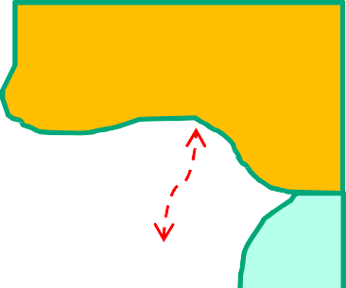

Use Application Frame to Design Software
Application Framework provides essential functions for consistent, efficient and quality software design
Application
Basic Components
Hand-shaking
Hand-shaking
Hand-shaking
(views, handlers,
assessors)
Component
Distinct Applications
Object
Middleware
Components
Hand-shaking
Hand-shaking
Specific Business Domain Components (business portfolio-level)
Network/Server Components
Cross Business Domain Components (enterprise-level)
System Software / Platform

Slide 134
Object Coupling (between objects)
Level of Coupling |  | Type of Object Relationship
loose |  | No direct coupling between objects
 |  | Passing reference to another object
 |  | Passing value to another object
 |  | Passing control data to another object
 |  | Common or global referenced by both objects
Tight |  | Content being referenced directly by another object

Slide 135
Class Cohesion
A class should has consistent information
Cohesion | If a class has …
Good cohesion | Single business concept (attributes related to the business)
 | Mixed business concepts (different business attributes)
 | Mixed business domain (different business areas)
Not good cohesion | Unrelated types of business (different concepts)

Slide 136
Method Coherence
Methods of a class should be related
Coherence | If methods of a class have …
Good Coherence | only a single function
 | connected/related functions
 | functions using same attributes
 | directly related functions
 | support indirectly related functions
 | supports other related functions of different objects
Not Good Coherence | has unrelated functions

Slide 137
Design Goals
Maximize the functional coherence within an encapsulation boundary (e.g. within a component or an object)
Minimize the functional coupling between the encapsulation boundaries (e.g. between two components or objects)

Slide 138
Design Application Components with Objects
Understand Business Requirements
Design Business Class Structure
Design Business Application Logic Flow
Design Statechart of Business Process Rules
Design Components of Business Application

Slide 139


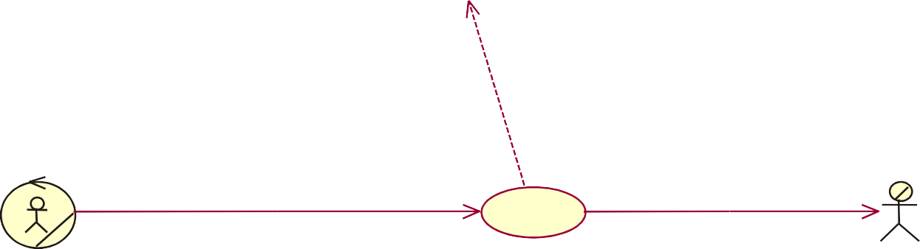

Understand Business Requirements
Sign-on
<<include>>
Profile
<<communicate>>
Request Service
<<system event>>
Access Customer Record
Customer
Process Request
Customer Record System
<<extend>>
<<communicate>>
process new case
<<system event>>
Get Credit Record
Business Person
Check Credit
External Business
System
Business User

Slide 140

Design Business Class Structure
Customer
FinancialServiceCustomer |  | 0..n
Customer Record
0..n
1..n
1
Service Application Form
Account Record
Service Log
Page 140

Slide 141
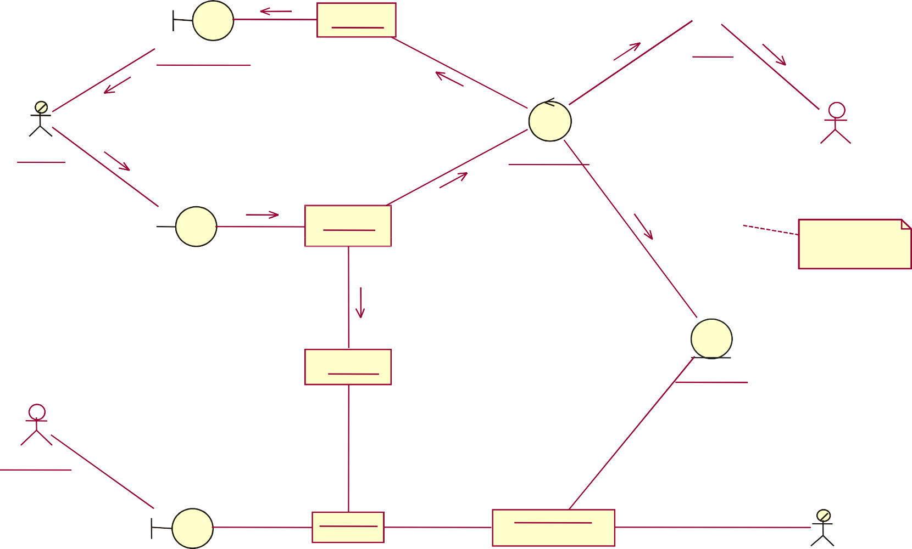
Design Business Application Logic Flow
9: Display Result Page
Report : PageServlet
5: Get Customer Record
: Customer Record
6: Access Customer Record
Statement : ClientPage
10: Inform Customer
8: Send Service Result
: Customer
1: Submit Application
: ProcessManager
: Customer Record System
2: Handle Request
4: Handle Service Request
Request : PageServlet
7: Send to Process Queue
if additional information needed or required
RequestForm : ClientPage
3: Authentication
Session : SingleSignOn
: Process Queue
: Business User
: PageServlet
: CreditEvaluation
: ClientPage
: External Business System
Page 141

Slide 142




Design Statechart of Business Process Rules
Completed Form
file
Submitted
process
Reviewed
updated
Review completeness
missing info
Pending
completed info
expired
Returned
Rejected
Review Content
not accepted
accepted
Approved

Slide 143
Design Components of Business Application
Credit Evaluation
External Business System
Client Page
Servlet
<<Application>> Process Request
Customer Data
PageUpdate
Customer Record
Java Servlet Page
Application DLL
Profile Database
From Operational Infrastructure
From Development Infrastructure

Slide 144
Data Persistence Design
Part 16

Slide 145
Data Persistence
Data Persistence Formats
Mapping Objects to an Relational Format
Optimizing RDBMS-based Object Storage
Design Considerations of Data Persistency

Slide 146
Data Persistence Formats
Sequential and Random Access Files
Relational Databases
Object-Relational Databases
Object-Oriented Databases
Selecting an Data Persistence Format

Slide 147
Mapping Objects to Relational Format
Create Persistent Object Models
– Extracted business data from the class hierarchy for data persistency to a relational database
Mapping Table
Object | Entity (Relational)
Class | Entity table
Object | Entity (Row)
Attribute | Column
Object identity attribute | Primary key (Entity key column)
Methods | Stored procedures
Association | Foreign key
Collections (whole-parts) | Association tables

Slide 148
Optimizing RDBMS-based Object Storage
Managed by the Book Management
Book Lending
key
Lending Transaction ID Date
Borrower Name
Borrower ID Book 1 Name Book 1 ID (ISBN)
Book 1 Type
Book 2 Name Book 2 ID (ISBN)
Book 2 Type
Book 3 Name
Book 3 ID (ISBN)
Book 3 Type
First-Normal Form:
Eliminate the repeating fields (columns)
key
Book Borrowing |  | Book
Lending Transaction ID |  | Book Name
Date |  | Book ID (ISBN)
Borrower Name Borrower ID | 0..* 1..* | Book Type Lending Status
Book ID (ISBN)
key

Slide 149
Optimizing RDBMS-based Object Storage
Book Borrowing
Lending Transaction ID Date
Borrower Name Borrower ID Book ID (ISBN)
Book
Book Name Book ID (ISBN)
Book Type Lending Status
Book Quantity Book Description
P
P
P P, F
0..*
1..*
Borrower Name only needs Borrower ID
Date only needs Lending Transaction ID
Second-Normal Form:
Remove field depending only
on partial key
Borrower
Borrower Name Borrower ID
Book Borrowed
Lending Transaction ID Date
Borrower ID
Book Book Name Book ID (ISBN)
Book Type Lending Status
Book Description Book Quantity
P
P
P
1
0..*_{F}
0..*
1..*
Borrow Book Lending Transaction ID Book ID (ISBN)
Identify joint keys for M:M relationships
P, F
P, F
P = Primary Key F = Foreign Key

Slide 150
Optimizing RDBMS-based Object Storage
Borrower
Borrower Name Borrower ID
Book Borrowed
Lending Transaction ID Date
Borrower ID
Book
Book Name Book ID (ISBN)
Book Type Lending Status
P
F P
P
1
0..*_{F}
0..*
0..*
1..*
Borrow Book
0..*
P, F
Book Description
P, F
Lending Transaction ID
Book ID (ISBN)
only needs Book Name
Third-Normal Form:
Remove field depending only on non primary key
1..1
Book Description Book Name
Book Description
P
Book Quantity
They are fields that only depending on
non-primary key “book name”
P = Primary Key F = Foreign Key
Page 150

Slide 151
Optimizing Data Access Speed
De-normalization
Reversing the normalization for performance
Clustering
Adding data fields (columns) to other tables for faster data retrieval (e.g. Borrower Name are in both Borrower and Book Borrowed)
Indexing
An indexing table has pre-sorted index based on a type for faster search (e.g. by “Text-book”, “Reference-book” and “novel” pointing at each data record as groups)

Slide 152
Design Considerations of Data Persistency
Store data in local memory for high access- frequency data that requires less update needs.
Do not store data in local memory for low access- frequency data that may require frequent update needs.
Make a design trade-off when data are high access- frequency and frequent update needs. The bottom line is the balance of time vs. space.

Slide 153
System Development – Design Summary
Phase | Step | Technique | Artifacts
Design (How will the system work?) | System design | Custom development Package development Outsourcing | Design strategy
 | Network design | Hardware design Network design | Technical architecture Infrastructure design
 | Interface design | Interface structure Input design Output design | Interface design
 | Database design (including any files) | Data schema Data storage | Physical data structure/table Data storage design
 | Object design (refined physical design) | Class diagrams Sequence diagrams | Program structure chart Program specifications

Slide 154
Implementation and Testing
Part 17

Slide 155
Manage Implementation
Resource Assignments
GUI development
Specialized business function
Foundation/Shared function
Data accessing/persistence
Networking/infrastructure communication
Manage the schedule
Development selections
Development dependencies
Change management
Incremental testing

Slide 156
Avoid Mistakes
Using “Bleeding Edge” Technology
Inexperience
Using Low-cost Personnel
Inexperience
Low quality
Lack of Code Control
No change management
Lack of development code standards
Inadequate Testing
No rigger test
No early test cost later major testing difficulties

Slide 157
Test Planning
Unit/Component Testing
Integration Testing
System Testing
Acceptance Testing

Slide 158
Unit/Component Testing
White-box Testing
Code
Error handling
Black-box Testing
Methods
Interfaces
Error test

Slide 159
Integration Testing
User Interface Testing
User interface functions
Error conditions
Use Case Testing
Use cases
Extended use cases
Special conditions
Interaction Testing
Business logic
Business transaction (data processing)
System Interfacing Testing
Data exchange

Slide 160
System Testing
Requirement Testing
Business requirements
Business process status/conditions
Usability Testing
Easy of use
Performance
Error reporting
Security Testing
Authorization
Authentication
Reliability Testing
System Monitoring
Disaster recover
Performance Testing
Stress
Scalability
Documentation Testing
Accuracy of HELP, procedure, tutorials
Page 160

Slide 161
Acceptance Testing
Beta Testing (pre-release)
User environments
User data
Alpha Testing (post-release)
Conducted by users
Acceptance test

Slide 162
Example of Test Plan Format
Use Case Name | Test Type | Test Conditions Settings / Field Values | Test Pattern (steps) | Expected Results | Actual Results | Pass / Not Pass | Comments

Slide 163
System Development – Implementation Summary
Phase | Step | Technique | Artifacts
Implementation (System delivery) | Construction | Programming Testing | Programs Test plan
 | Installation | Direct Online Creating Training plan | Configured system Training plan
 | Support | Support strategy Post-implementation review | Support/service plan

Slide 164
Final Course Review
Part 18

Slide 165
Review of System Analysis and Design
Capture the business function process
Create use cases
Use activity models for detail process for each use case as needed
Identify requirements
Analyze the system components to realize the business needs
Class structures to support the business data and functions
Model their interactions
Model their internal behaviors

Slide 166
Review of System Analysis and Design (continued)
Create system design models
Transform the Analysis-level models as base for creation of design
Decompose the high-level classes
Add design structures to support business objects
Add interfaces with underlying development framework, library, system component, utilities
Design specific components using class diagrams, interaction diagrams, state diagrams:
User interfaces
Business components/objects
Interfaces with other applications or components
Interfaces to the back-end data accessing capabilities
Define deployment model:
User environments
Business process distributions
Operational environment, network, security
Hardware specifications

Slide 167

Review of System Development Process
New idea
Define Business Process
Business Process Automation
Development Planning
Re-engineering
Change Business Process
System Analysis
System Design
Production System Installation
System Implementation
Production System Support

Slide 168
Key Learning from This Course
You have learned … …
Software system analysis and design
Software analysis and design concepts
Analysis and design artifacts
Software system development lifecycle
Fundamental analysis and design process
Software system architect basic skills

Slide 169
Thank you …
Wish you all
have great accomplishments in your academic studies and
feature success！

Slide 170
Student Practice
Appendix
Page 170

Slide 171
Student Practice – Create Use Case Model
Add a use case of “Renew book”
Write use case descriptions for “Check-out Book”
Students present models

Slide 172
Student Practice – Create Analysis Model
Create a collaboration diagram for “Check-in book”
Add new class structures to support
“Magazine”
“Staffs” of the school
Student presents models

Slide 173
Student Practice - Create Design Models
Create application flow for “check-in book” and “check-out book”:
User interface
System application logic flow (UI, flow control, data access)
Create database table
Show deployment diagram
Students present models

